Slide 1
Module-2
Mapping ER model to Relational Schema

Slide 2
ER to Relational Schema Mapping
7 Steps

Slide 3
ER to Relational Schema Mapping
Step 1: Mapping of Regular Entity Types
Step 2: Mapping of Weak Entity Types
Step 3: Mapping of Binary 1:1 Relation Types
Step 4: Mapping of Binary 1:N Relationship Types.
Step 5: Mapping of Binary M:N Relationship Types.
Step 6: Mapping of Multi valued attributes.
Step 7: Mapping of N-ary Relationship Types.

Slide 4
Step 1: Mapping of Regular Entity Types

Slide 5
Step 1: Mapping of Regular Entity Types
Create a relation R that includes all simple attributes of E
Each entity became a table
Each single value attribute becomes column
Derived attributes are ignored
Composite attribute represented by components
Key attribute became the primary key of the table

Slide 6
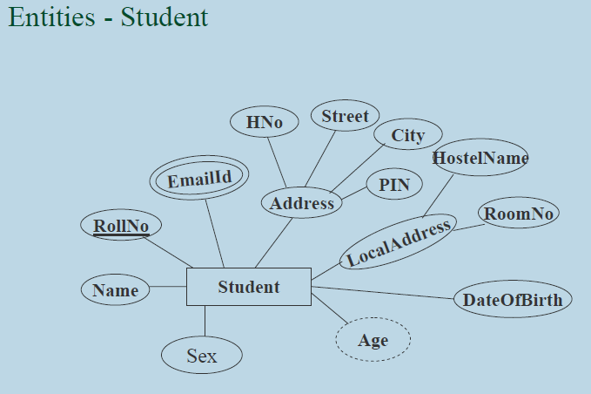
Step 1: Mapping of Regular Entity Types

Slide 7
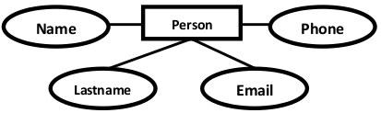
Step 1: Mapping of Regular Entity Types
student
Roll_No (PK)
Name
Sex
….
….
Persons( personid , name, lastname, email, Phone )

Slide 8
Step 2: Mapping of Weak Entity Types

Slide 9
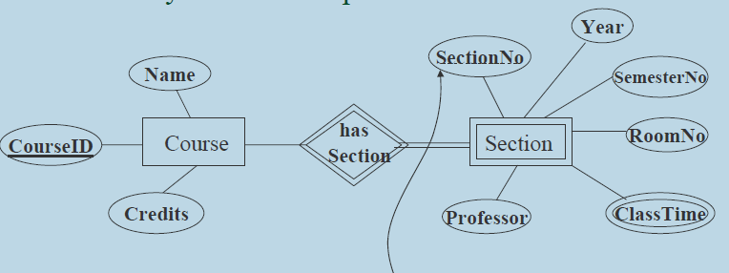
Step 2: Mapping of Weak Entity Types

Slide 10
Step 2: Mapping of Weak Entity Types
Course
Course_ID (PK)
Course Name
Course credits
….
Section
Section_ID (PK)
Course_ID (FK)
Section Name
Class No.
…..

Slide 11
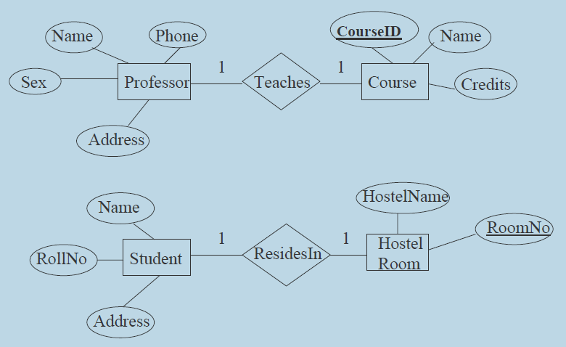
Step 3: Mapping of Binary 1:1 Relation Types

Slide 12
Step 3: Mapping of Binary 1:1 Relation Types
Professor
Professor_ID (PK)
Professor Name
Teaches (Course_ID)
….
….
Course
Course_ID (PK)
Course Name
…..

Slide 13
Step 3: Mapping of Binary 1:1 Relation Types
Employee manages the department
Employee sits on the chair
Chair used by the employee

Slide 14
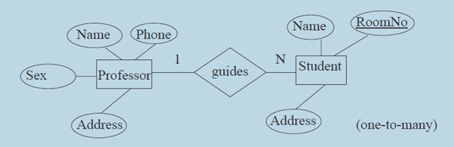
Step 4: Mapping of Binary 1:N Relationship Types

Slide 15
Step 4: Mapping of Binary 1:N Relationship Types
Professor
Professor_ID (PK)
Professor Name
….
….
….
Student
Student Roll No (PK)
Student Name
…..
Guide ID (FK) (Professor_ID)

Slide 16
Step 4: Mapping of Binary 1:N Relationship Types
Teacher teaches many subjects
Student registered many courses

Slide 17
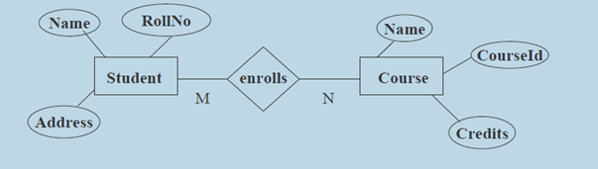
Step 5: Mapping of Binary M:N Relationship Types

Slide 18
Step 5: Mapping of Binary M:N Relationship Types
Course
course_ID (PK)
course Name
….
Student
Student Roll No (PK)
Student Name
…..
enrolls
Course ID (FK)
Student ID (FK)

Slide 19
Step 6: Mapping of Multi valued attributes

Slide 20
Step 6: Mapping of Multi valued attributes
Employee
Emp_ID (PK)
Emp_First Name
Emp_Last Name
….
….
Emp-Email_Id
Email_ID
Emp_ID (FK)

Slide 21
Step 7: Mapping of N-ary Relationship Types
Doctor prescribed medicine to a patient

Slide 22
Step 7: Mapping of N-ary Relationship Types
Doctor prescribed medicine to a patient
Doctor
Doctor_ID
Name
…..
Patient
Patient_ID
Patient Name
……
Medicine
Medicine_ID
Medicine Name
…..
Prescription
Doctor_ID
Medicine_ID
Patient_ID
Next Visit

Slide 23
Relational Schema
It Consists of relation name and set of attributes (or) column names.
Each attribute has an associated with domain (set of atomic values, i.e. data type).
Example:
Student { Student name : string
Roll Number : string
Phone Number : integer
Year of admission : integer
Branch : string }

